Slide 1
Chapter 9: IOS Images and Licensing
Scaling Networks
Notes:
Cisco Networking Academy program
Scaling Networks
Chapter 9: IOS Images and Licensing

Slide 2
Chapter 9
9.0 Introduction
9.1 Managing IOS System Files
9.2 IOS Licensing
9.3 Summary
Notes:
Chapter 9

Slide 3
Chapter 9: Objectives
Understand the necessity of managing IOS system image files to increase network reliability in a small-to-medium-sized business network.
Explain the Cisco IOS image naming conventions.
Calculate memory requirements needed when upgrading an IOS system image.
Explain the licensing process for the Cisco IOS software in a small-to-medium-sized business network.
Configure a router to install a Cisco IOS image license.
Notes:
Chapter 9 Objectives

Slide 4
Introduction Introduction
This chapter describes the following Cisco IOS concepts and features:
The Cisco IOS portfolio supports a broad range of technologies and features.
Customers choose an IOS based on a set of protocols and features supported by a particular image.
The Cisco IOS 12.5 and 15 packaging and naming conventions.
Beginning with IOS 15, Cisco also implemented a new packaging format and licensing process for IOS.
Process of obtaining, installing, and managing Cisco IOS 15 software licenses.
Notes:
9.0 Introduction
9.0.1.1 Introduction

Slide 5
Naming Conventions Cisco IOS Software Release Families and Trains
A software release family is comprised of multiple IOS software release versions that:
Share a code base
Apply to related hardware
Overlap in support coverage
Examples of IOS releases, within a software release family, include 12.3, 12.4, 15.0, and 15.1.
A Cisco IOS train is a version of the software released to implement bug fixes and add new features.
Notes:
9.1 Managing IOS System Files
9.1.1 Naming Conventions
9.1.1.1 Cisco IOS Software Release Families and Trains

Slide 6
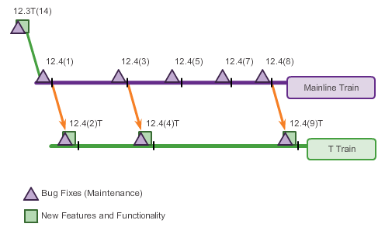
Naming Conventions Cisco IOS 12.4 Mainline and T Trains
The Cisco IOS software 12.4 train is considered the mainline train.
It receives mostly software (bug) fixes
Releases are designated as Maintenance Deployment (MD) releases
Is always associated with a technology train (T train)
Notes:
9.1 Managing IOS System Files
9.1.1 Naming Conventions
9.1.1.2 Cisco IOS 12.4 Mainline and T Trains

Slide 7
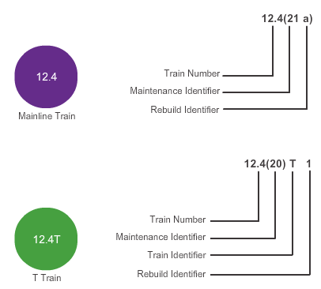
Naming Conventions Cisco IOS 12.4 Mainline and T Numbering
The IOS release numbering convention is used to identify the release of the IOS software, including any bug fixes and new software features.
Notes:
9.1 Managing IOS System Files
9.1.1 Naming Conventions
9.1.1.3 Cisco IOS 12.4 Mainline and T Numbering

Slide 8
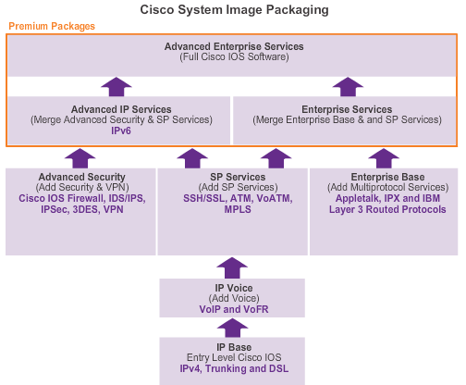
Naming Conventions Cisco IOS 12.4 System Image Packaging
Pre Cisco IOS Software Release 15.0, the Cisco IOS Software Packaging consisted of eight packages for Cisco routers.
Notes:
9.1 Managing IOS System Files
9.1.1 Naming Conventions
9.1.1.4 Cisco IOS 12.4 System Image Packaging

Slide 9
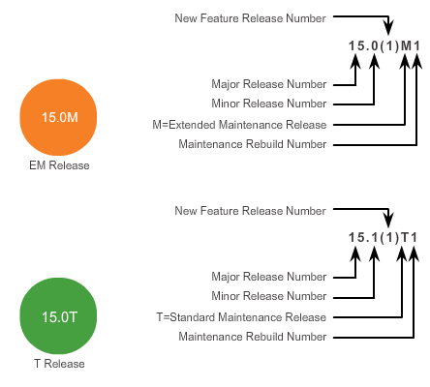
Naming Conventions Cisco IOS 15.0 Train Numbering
Extended Maintenance (EM) Release – The EM release is ideal for long-term maintenance, which enables customers to qualify, deploy, and remain on the release for an extended period.
Standard Maintenance (T) Release – The T release is used for short-deployment releases, which is ideal for the latest new features and hardware support before the next EM release becomes available.
Notes:
9.1 Managing IOS System Files
9.1.1 Naming Conventions
9.1.1.6 Cisco IOS 15 Train Numbering

Slide 10
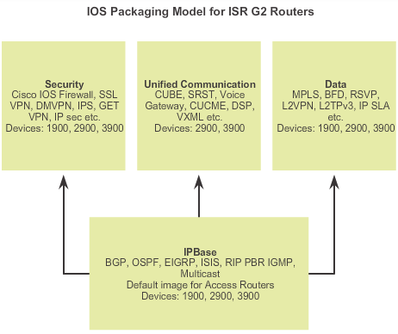
Naming Conventions IOS 15 System Image Packaging
Notes:
9.1 Managing IOS System Files
9.1.1 Naming Conventions
9.1.1.7 Cisco IOS 15 System Image Packaging

Slide 11
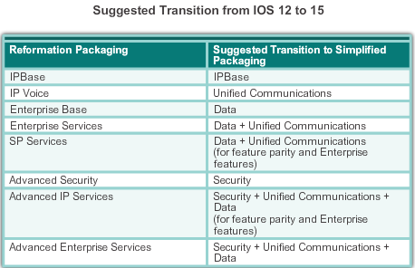
Naming Conventions IOS 15 System Image Packaging (cont.)
Notes:
9.1 Managing IOS System Files
9.1.1 Naming Conventions
9.1.1.7 Cisco IOS 15 System Image Packaging

Slide 12
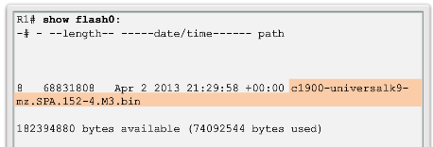
Naming Conventions IOS Image Filenames
Displaying the Cisco IOS image.
Notes:
9.1 Managing IOS System Files
9.1.1 Naming Conventions
9.1.1.8 IOS Image Filenames

Slide 13
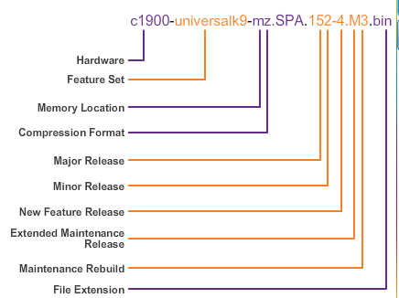
Naming Conventions IOS Image Filenames (cont.)
Example of a Cisco IOS 15.2 Image name.
Notes:
9.1 Managing IOS System Files
9.1.1 Naming Conventions
9.1.1.8 IOS Image Filenames

Slide 14
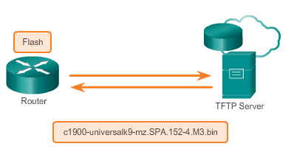
Managing Cisco IOS Images TFTP Servers as a Backup Location
Cisco IOS Software images and configuration files can be stored on a central TFTP server.
It is good practice to keep a backup copy of the Cisco IOS software image.
Using a network TFTP server allows image and configuration uploads and downloads over the network.
Notes:
9.1 Managing IOS System Files
9.1.2 Managing Cisco IOS Images
9.1.2.1 TFTP Servers as a Backup Location

Slide 15
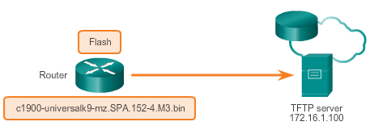
Managing Cisco IOS Images Creating Cisco IOS Image Backup
To create a backup of the Cisco IOS image to a TFTP server, perform the following three steps:
Step 1. Ensure that there is access to the network TFTP server. Ping the TFTP server to test connectivity.
Step 2. Verify that the TFTP server has sufficient disk space to accommodate the Cisco IOS Software image. Use the show flash0: command on the router to determine the size of the Cisco IOS image file.
Step 3. Copy the image to the TFTP server using the copy source-url destination-url command.
Notes:
9.1 Managing IOS System Files
9.1.2 Managing Cisco IOS Images
9.1.2.2 Creating Cisco IOS Image Backup

Slide 16
Managing Cisco IOS Images Copying a System IOS Image
Follow these steps to upgrade the software on the Cisco router:
Step 1. Select a Cisco IOS image file that meets the requirements in terms of platform, features, and software. Download the file from http://www.cisco.com and transfer it to the TFTP server.
Step 2. Verify connectivity to the TFTP server. Ping the TFTP server from the router.
Step 3. Ensure that there is sufficient flash space on the router that is being upgraded. The amount of free flash can be verified using the show flash0: command.
Step 4. Copy the IOS image file from the TFTP server to the router using the copy tftp: flash0 command. After issuing this command with specified source and destination URLs, the user is prompted for the remote host’s IP address, source filename, and destination filename. The transfer of the file then begins.
Notes:
9.1.2.3 Copying a System IOS Image

Slide 17
Managing Cisco IOS Images Boot System
The boot system commands specify the name and location of the Cisco IOS Software image to load. Several boot system commands can be entered in sequence.
Specify the flash device as the source of the Cisco IOS image:
Router(config)# boot system flash0://c1900-universalk9-mz.SPA.152-4.M3.bin
Specify the TFTP server as a source of the Cisco IOS image, with ROMmon as the backup:
Router(config)# boot system tftp://c1900-universalk9-mz.SPA.152-4.M3.bin
Router(config)# boot system rom
Notes:
9.1.2.4 Boot System

Slide 18
Software Licensing Licensing Overview
The Cisco IOS Software Release 15.0 incorporates cross-platform feature sets to simplify the image selection process.
Each device ships with the same universal image.
Technology packages are enabled in the universal image via Cisco Software Activation licensing keys.
Technology package licenses are supported on Cisco ISR G2 platforms (Cisco 1900, 2900, and 3900 Series routers).
Use the show license feature command to view the technology package licenses and feature licenses supported on the router.
Notes:
9.2.1.1 Licensing Overview

Slide 19
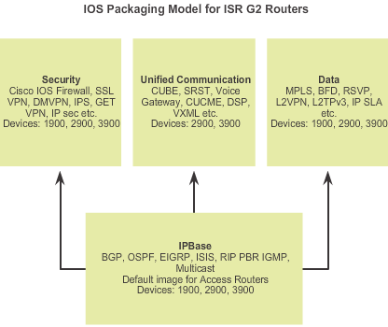
Software Licensing Licensing Overview
Notes:
9.2.1.1 Licensing Overview

Slide 20
Software Licensing Licensing Process
A new router is shipped preinstalled with the software image and the corresponding permanent licenses for the customer-specified packages and features.
Also comes with the evaluation license, known as a temporary license, for most packages and features supported on the specified router for customer review.
Notes:
9.2.1.2 Licensing Process

Slide 21
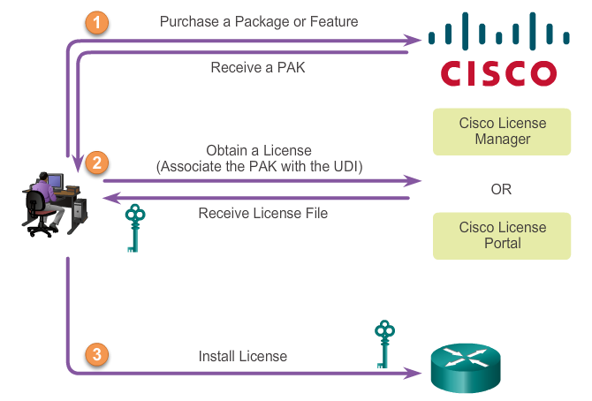
Software Licensing Licensing Process (cont.)
There are three steps to permanently activate a new software package or feature on a router.
Step 1. Purchase a
package or feature.
Step 2. Obtain a license
Step 3. Install license
Notes:
9.2.1.2 Licensing Process

Slide 22
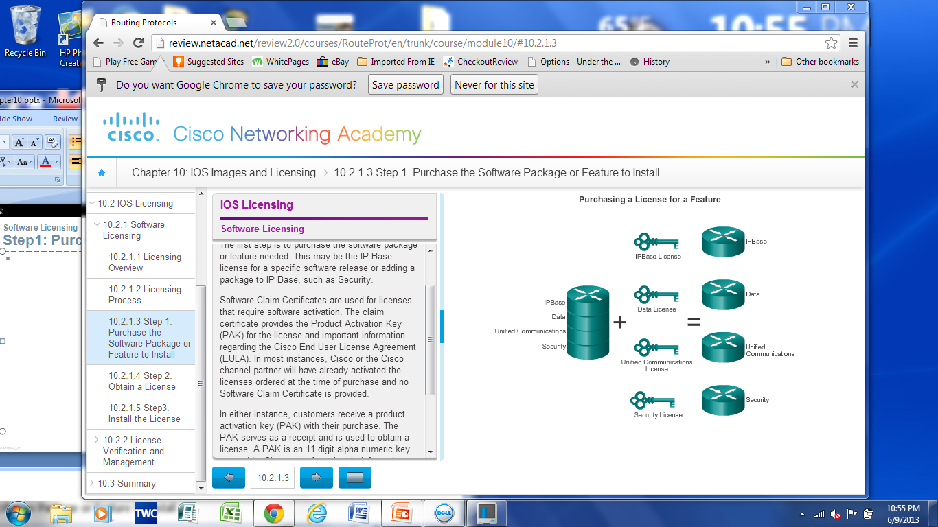
Software Licensing Step 1: Purchase the Software Package
The first step is to purchase the software package or feature needed.
Software Claim Certificates are used for licenses that require software activation. They provide Product Activation Key (PAK) and important information regarding the Cisco End User License Agreement (EULA).
Notes:
9.2.1.3 Step1: Purchase the Software Package or Feature to install

Slide 23
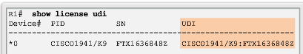
Software Licensing Step 2: Obtain a License
The second step is to obtain a license or license file using one of the following options:
Cisco License Manager (CLM) is a free software application available at http://www.cisco.com/go/clm.
The Cisco License Manager can discover network devices, view their license information, and acquire and deploy licenses from Cisco.
Cisco License Registration Portal is the web-based portal for obtaining and registering individual software licenses, available at http://www.cisco.com/go/license.
Both options require a PAK number and a unique device identifier (UDI).
Notes:
9.2.1.4 Step2: Obtain a License

Slide 24
Software Licensing Step 3: Install the License
After obtaining the license file (an XML text file with a .lic extension), you must install a permanent license:
Step 1: Use the license install stored-location-url privileged EXEC mode command to install a license file.
Step 2: Reload the router using the reload privileged EXEC mode command. A reload is not required if an evaluation license is active.
After a permanent license is installed on a router, it is good for that particular feature set for the life of the router, even across IOS versions.
Cisco manufacturing preinstalls the appropriate permanent license on the ordered device for the purchased feature set; therefore, it’s not necessary to enable that license on new hardware.
Note: Unified Communications is not supported on 1941 routers.
Notes:
9.2.1.5 Step3: Install the License

Slide 25
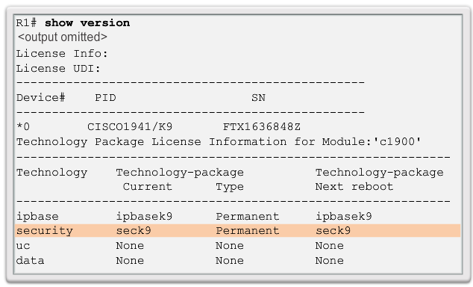
License Verification and Management License Verification
Permanent License Verification – show version command
Notes:
9.2.2.1 License Verification

Slide 26
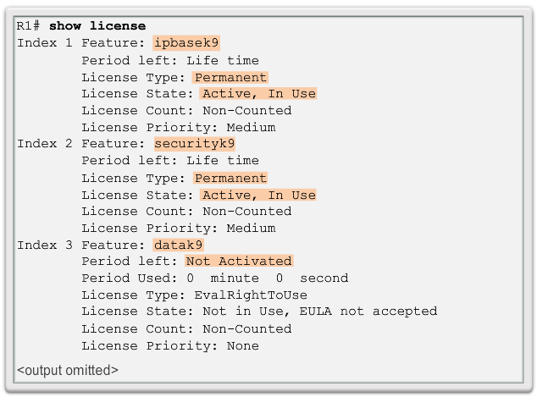
License Verification and Management License Verification
License Verification – show license command
Courier new bold 20 the commands
Consider breaking this into two slides, you cant read the graphic. Consider adding a lead in for each slide if split.
Notes:
9.2.2.1 License Verification

Slide 27
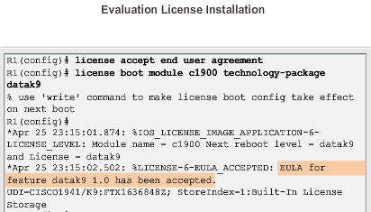
License Verification and Management Activate an Evaluation Right-to-Use License
An Evaluation License is good for a 60 day evaluation period. After the 60 days, this license automatically transitions into an Right-to-Use (RTU) license.
Use the show license command to verify that the license has been installed.
Notes:
9.2 IOS Licensing
9.2.2 License Verification and Management
9.2.2.2 Activate an Evaluation Right-to-Use License

Slide 28
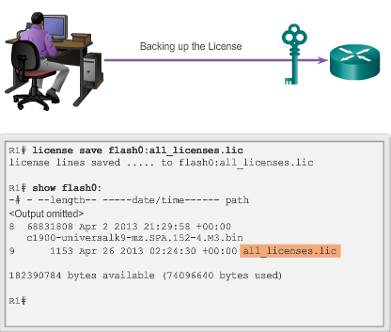
License Verification and Management Backing Up the License
Notes:
9.2.2.3 Backing Up the License

Slide 29
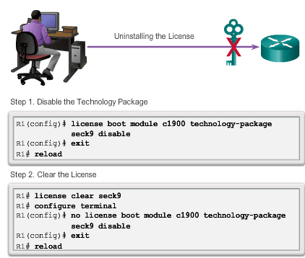
License Verification and Management Uninstalling the License
Notes:
9.2.2.4 Uninstalling the License

Slide 30
Chapter 9: Summary
This chapter described and outlined the following concepts:
Examples of Cisco IOS software releases include 12.3, 12.4, 15.0, and 15.1
Cisco IOS software 12.4 incorporates new software features and hardware support (introduced in the Cisco IOS Software 12.3T train and additional software fixes).
Prior to and including 12.4, the mainline “M” train received bug fixes only. The technology “T” train include fixes, new features, and platforms.
The Cisco IOS 15.0 release family incorporates M and T releases in the same train.
Select the proper IOS image with the correct feature set and version.
The Cisco IOS image file uses a specific naming convention consisting of multiple parts each with a specific meaning.
Notes:
Chapter 9 Summary

Slide 31
Chapter 9: Summary (cont.)
Commands are available for upgrading and verification of flash; for example, show flash, boot system.
Network TFTP server allows image and configuration uploads and downloads over the network.
With Cisco IOS Software release 15.0, Cisco modified the process to enable new technologies within the IOS feature sets. Each device ships with a universal image.
Technology packages, such as IP Base, DATA, UC, and SEC are enabled in the universal image via Cisco software activation licensing keys.
Licensing keys are unique to a particular device and are obtained from Cisco by providing the product ID and serial number of the router and a Product Activation Key (PAK).
Notes:
Chapter 9 Summary

Slide 32
Chapter 9: Summary (cont.)
A permanent license is a license that never expires, even if the router is upgraded to a new IOS release.
Use the show license udi command to install a license a PAK, a Cisco username/password, serial number, and PID of the.
Use the show version command to verify that license has been installed.
Use the show license command to display information about Cisco IOS licenses.
Notes:
Chapter 9 Summary

Slide 33


